Slide 1


House Interior Design

Slide 2




SUPERVISED BY:
DR. Mahmoud Wahdan
T.A. Omar Khaled
T.A. Nada Tarek

Slide 3
Team Members
Shahd Mostafa Sayed Hassan
Sohaila Ashraf Mohamed Salem
Nada Ashraf Abdalla Mohamed
Sophia Nabil Zaki Nawer
Abdallah Qusay Abdallah Sabah
AbdElhdy Amged Abdelhgny Farag
Abdelmogoud Morsi Abdelmogoud
Youssef Amr Taha Mohammed

Slide 4
AGENDA
01
06
PROBLEM STATEMENT
SYSTEM ANALYSIS PHASE
02
07
OBJECTIVES
SYSTEM DESIGN PHASE
03
08
SOLUTION APPROACH
IMPLEMENTATION PHASE
04
09
PROJECT PLANNING
System Testing
05
10
SURVEY & LITERATURE REVIEW
Conclusion &Future Work

Slide 5
AGENDA
01
06
PROBLEM STATEMENT
SYSTEM ANALYSIS PHASE
02
07
OBJECTIVES
SYSTEM DESIGN PHASE
03
08
SOLUTION APPROACH
IMPLEMENTATION PHASE
04
09
PROJECT PLANNING
System Testing
05
10
SURVEY & LITERATURE REVIEW
Conclusion &Future Work

Slide 6


PROBLEM STATEMENT
This project is offering a variety of catalogs for the basic needs in house decoration, furniture, lighting and accessories from different stores so it become easy and simple for users who prepare their house to find it all in the same website.
This project reduces time and money consumed in searching for what they need in different furniture, decoration and lighting stores or surfing a lot of websites.
.

Slide 7
PROBLEM STATEMENT (Cont.)
Users will be individual users who want to buy furniture and furniture stores who want to add their new products and recent offers.
.

Slide 8
AGENDA
01
06
PROBLEM STATEMENT
SYSTEM ANALYSIS PHASE
02
07
OBJECTIVES
SYSTEM DESIGN PHASE
03
08
SOLUTION APPROACH
IMPLEMENTATION PHASE
04
09
PROJECT PLANNING
System Testing
05
10
SURVEY & LITERATURE REVIEW
Conclusion &Future Work

Slide 9
OBJECTIVES
Providing everything the customer needs to design his home in one application
Save time of the costumer
.

Slide 10
AGENDA
01
06
PROBLEM STATEMENT
SYSTEM ANALYSIS PHASE
02
07
OBJECTIVES
SYSTEM DESIGN PHASE
03
08
SOLUTION APPROACH
IMPLEMENTATION PHASE
04
09
PROJECT PLANNING
System Testing
05
10
SURVEY & LITERATURE REVIEW
Conclusion &Future Work

Slide 11
SOLUTION APPROACH
Facilitating The Shopping Process And Saving Time
The customer can access and see the review for the product
Enhancing filtering and search functionality for easier product discovery.
.

Slide 12
AGENDA
01
06
PROBLEM STATEMENT
SYSTEM ANALYSIS PHASE
02
07
OBJECTIVES
SYSTEM DESIGN PHASE
03
08
SOLUTION APPROACH
IMPLEMENTATION PHASE
04
09
PROJECT PLANNING
System Testing
05
10
SURVEY & LITERATURE REVIEW
Conclusion &Future Work

Slide 13
Project Task ASSIGNMENT
Task# | Task Name | Preceding event | Resource Name
1 | Problem Definition | - | ALL
2 | Objective | 1 | ALL
3 | similar System | 2 | All
4 | Technologies&Requirement | 2 | All
5 | Data flow Diagram | 3 | Shahd, Sohaila, Nada, Sophia, Abdalhady
6 | ERD | 4 | Yousif, Abdelmougoud, Abdalah
7 | schema | 6 | Yousif, Shahd, Abdalah
8 | input/output interface | 5 | Sohaila, Nada, Sophia, Abdalhady, Abdelmougoud
9 | Front end | 8 | Sohaila ,Nada , Abdalah , Abdalhady
10 | Backend | 7 | Shahd, Sophia ,yousif, Abdelmougoud
11 | System Testing | 9,10 | All
12 | System Demo | 9,10 | All
13 | System Documentation | 12
14 | System Presentation | 13,12 | All

Slide 14
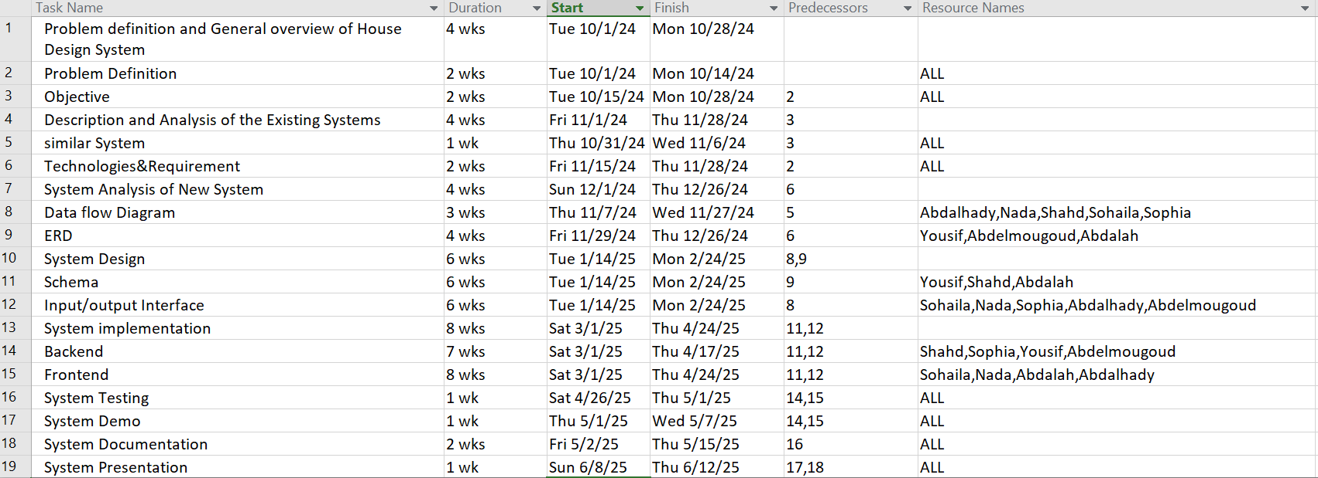
Task Sheet

Slide 15


Project Activity Slack Management
Task# | Preceding event | Expected duration | Early Finish | Late finish | Slack | Critical Path
1 | - | 2 | 2 | 2 | 0
2 | 1 | 2 | 4 | 4 | 0
3 | 2 | 1 | 5 | 6 | 1
4 | 2 | 2 | 6 | 6 | 0
5 | 3 | 3 | 8 | 9 | 1
6 | 4 | 4 | 10 | 10 | 0
7 | 6 | 6 | 16 | 16 | 0
8 | 5 | 6 | 14 | 15 | 1
9 | 8 | 8 | 22 | 23 | 1
10 | 7 | 7 | 23 | 23 | 0
11 | 9,10 | 1 | 24 | 26 | 2
12 | 9,10 | 1 | 24 | 24 | 0
13 | 12 | 2 | 26 | 26 | 0
14 | 13,12 | 1 | 27 | 27 | 0

Slide 16
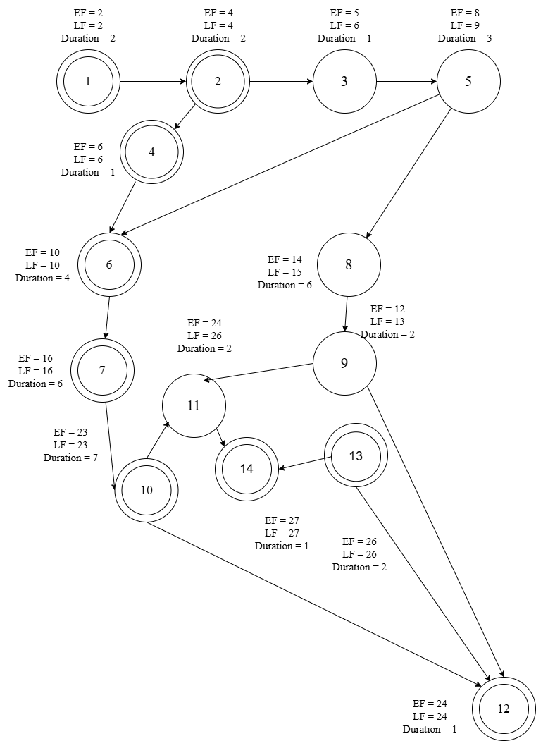
NETWORK DIGRAM

Slide 17
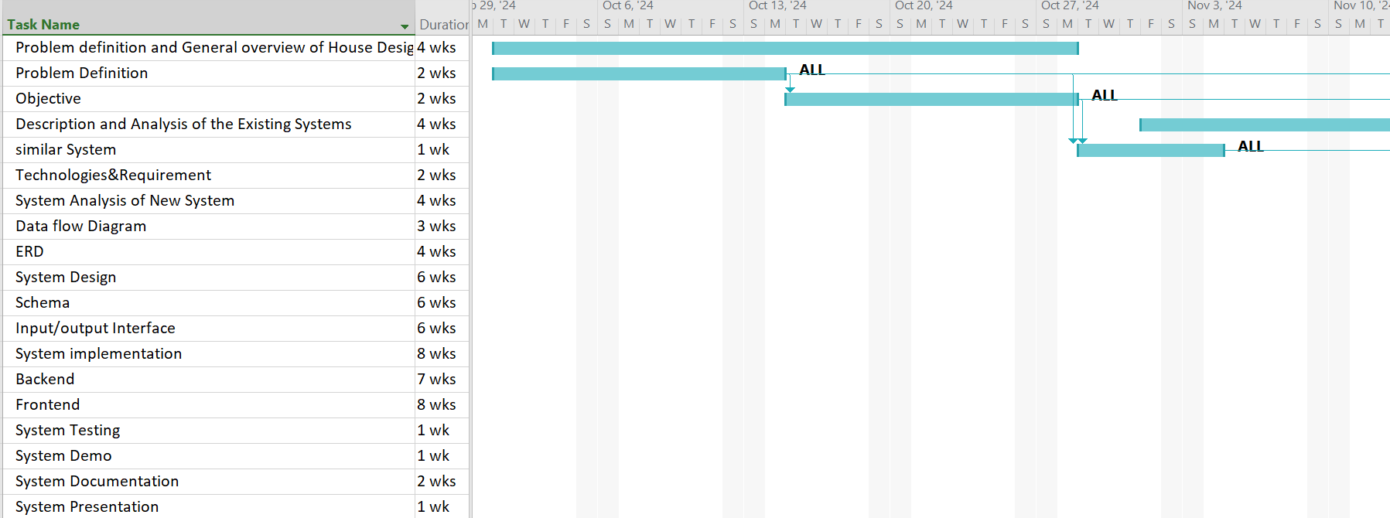
Gant Chart

Slide 18
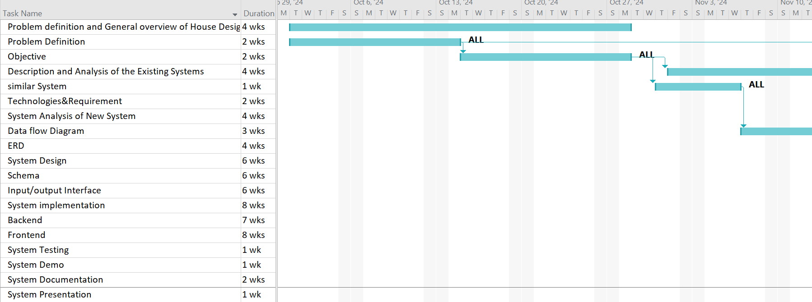
Gant Chart

Slide 19
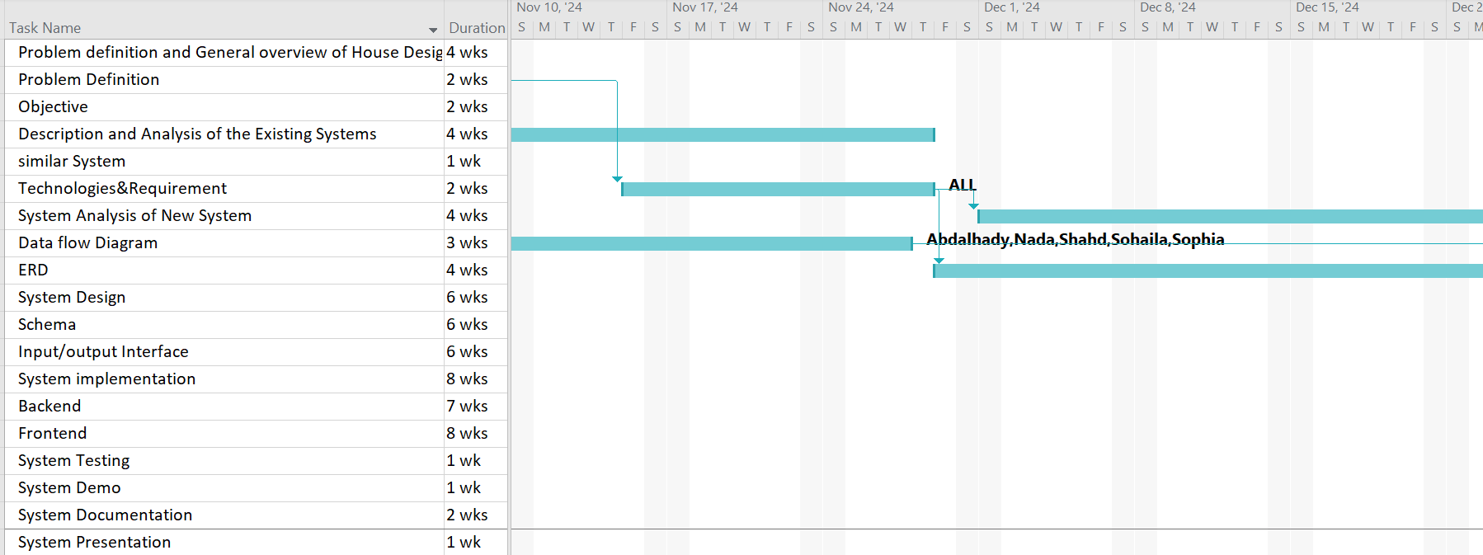
Gant chart

Slide 20
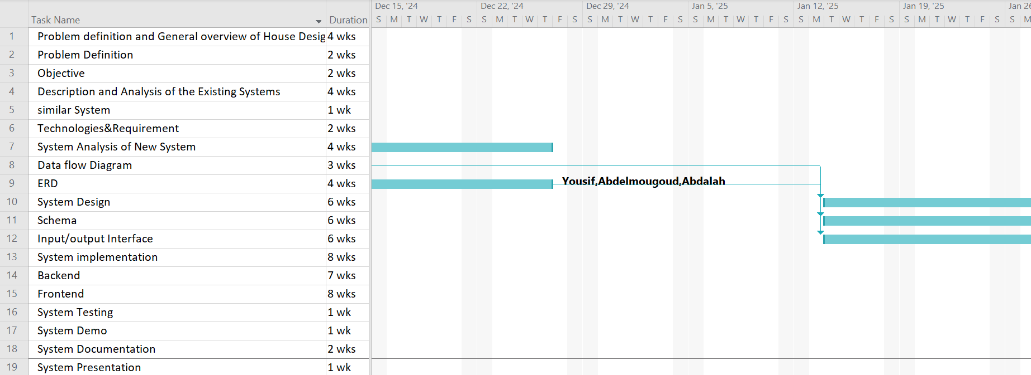
Gant Chart

Slide 21
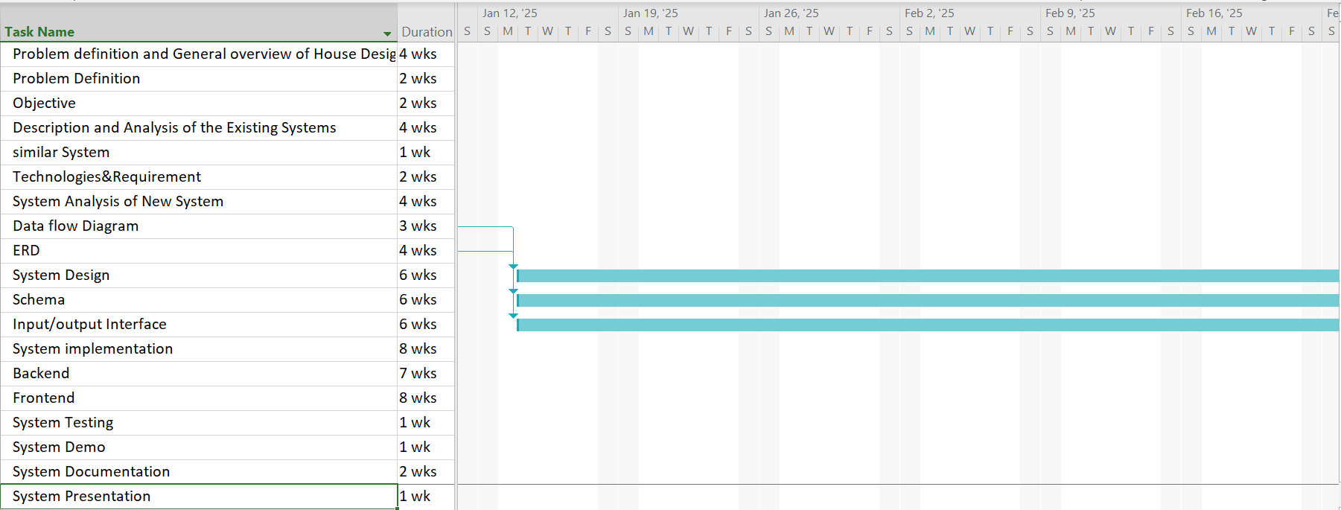
Gant Chart

Slide 22
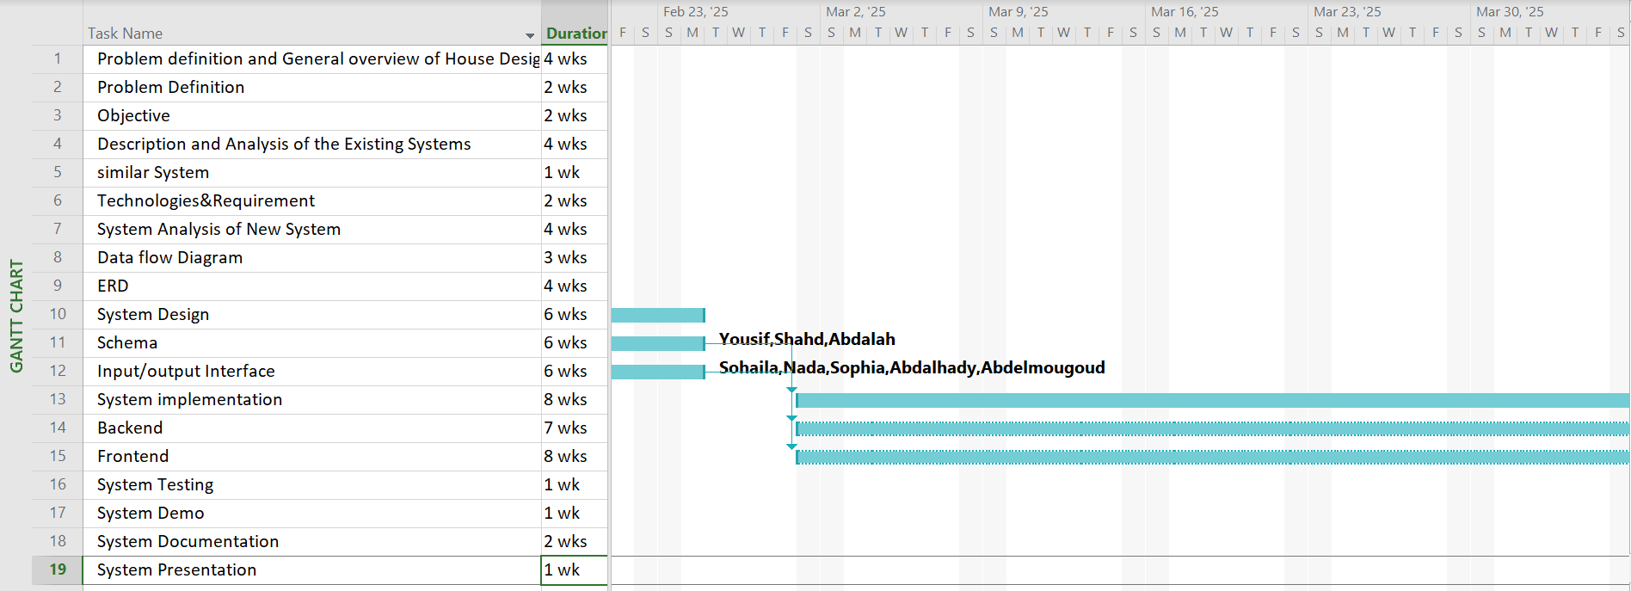
Gant Chart

Slide 23
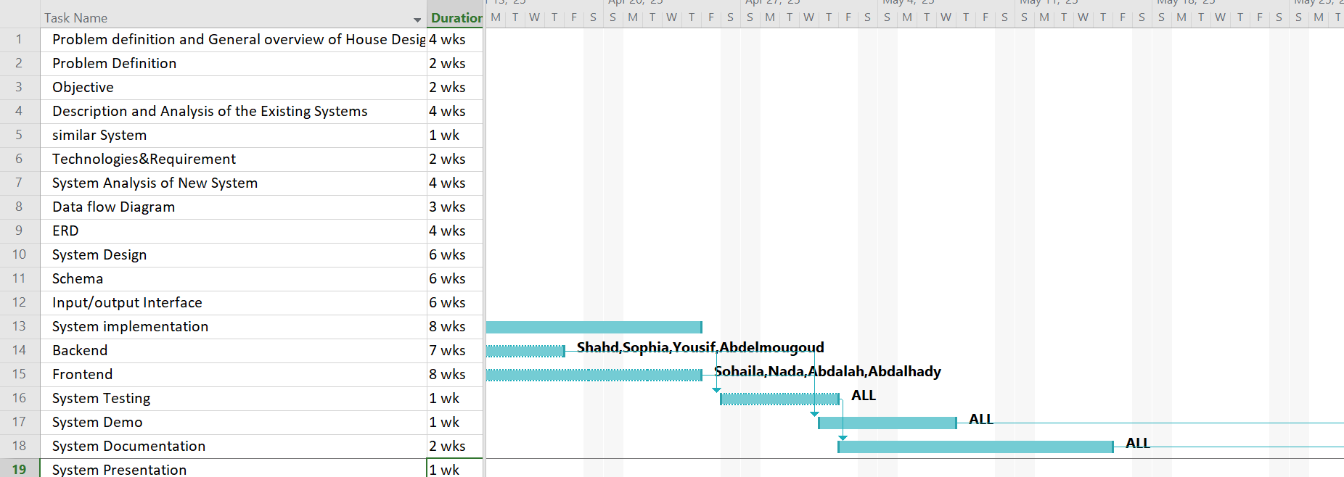
Gant Chart

Slide 24
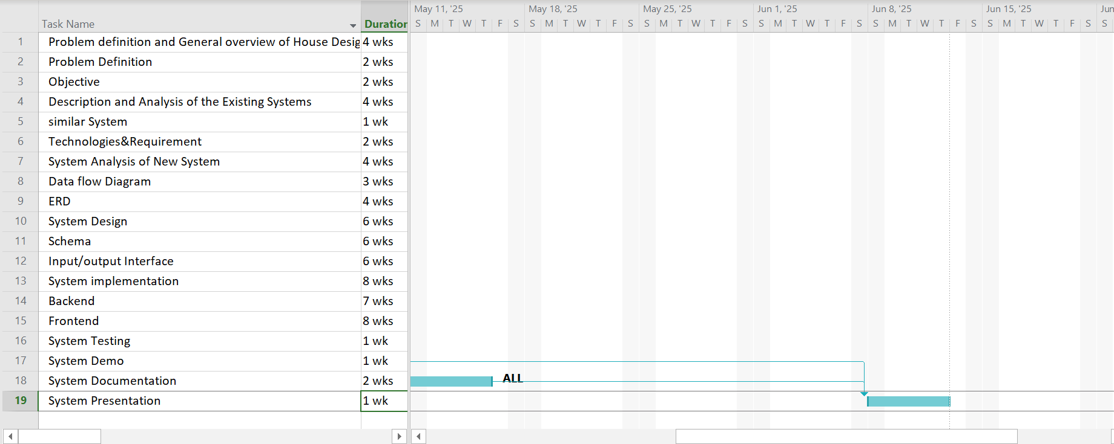
Gant Chart

Slide 25
AGENDA
01
06
PROBLEM STATEMENT
SYSTEM ANALYSIS PHASE
02
07
OBJECTIVES
SYSTEM DESIGN PHASE
03
08
SOLUTION APPROACH
IMPLEMENTATION PHASE
04
09
PROJECT PLANNING
System Testing
05
10
SURVEY & LITERATURE REVIEW
Conclusion &Future Work

Slide 26


Similar Systems
Application name | Advantages | Disadvantages
 | User friendly design well structured categories 3D visualizers Inspirational room ideas and guides help customers visualize how products fit into their homes. Ikea planner | Stock availability issues Navigation complexity for new user A lot of technical issues like performance issues.
 | User-Friendly Interface | limiting its global accessibility lack interactive features

Slide 27


Similar Systems(cont.)
Application name | Advantages | Disadvantages
 | Many of payment method | Limited Product Range Complex Checkout Process
 | emphasizes a user-friendly experience with easy-to-navigate interfaces interior design service quick view option | Limited International Reach Delivery Complaints

Slide 28

Similar systems(cont.)
Application name | Advantages | Disadvantages
 | Room planner Easy to return product(return police) | Return Restrictions High Shipping Costs Customer Service Issues

Slide 29
AGENDA
01
06
PROBLEM STATEMENT
SYSTEM ANALYSIS PHASE
02
07
OBJECTIVES
SYSTEM DESIGN PHASE
03
08
SOLUTION APPROACH
IMPLEMENTATION PHASE
04
09
PROJECT PLANNING
System Testing
05
10
SURVEY & LITERATURE REVIEW
Conclusion &Future Work

Slide 30
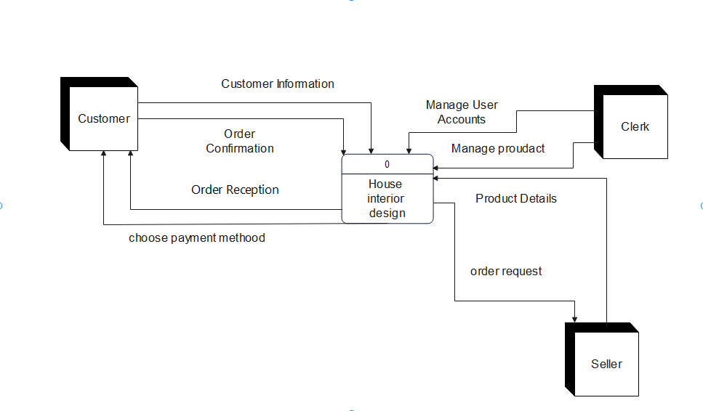
Context Diagram

Slide 31
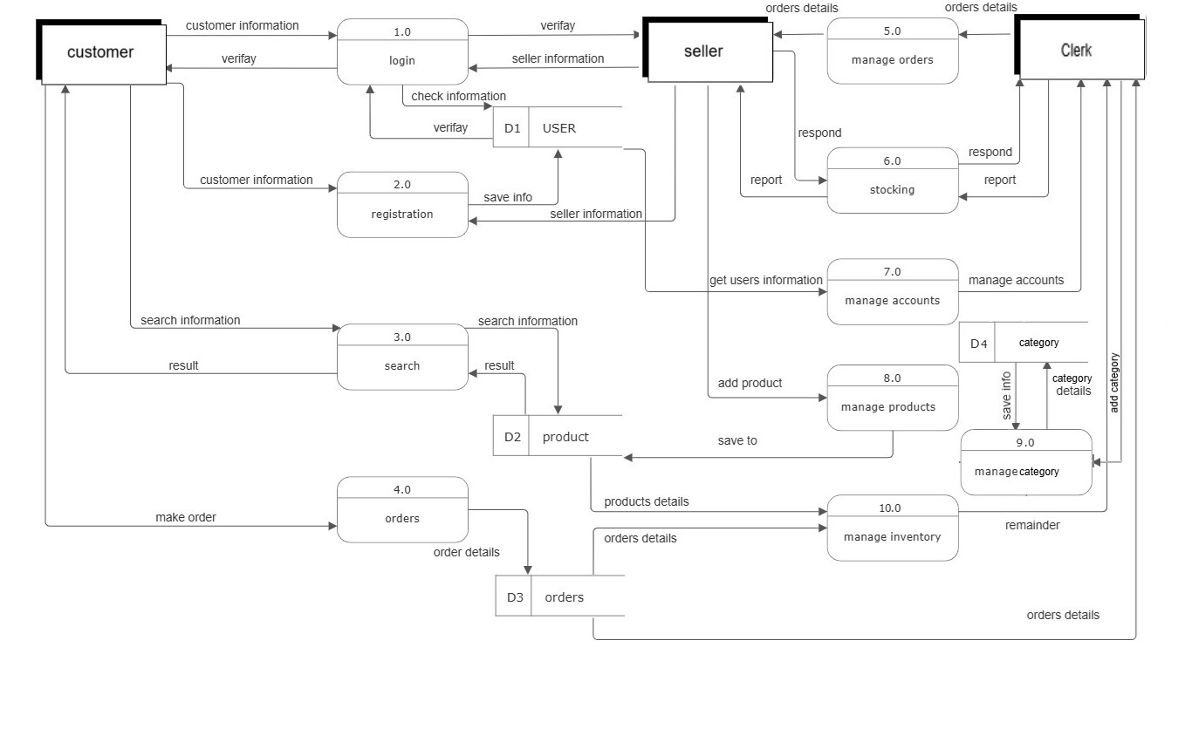
DFD LEVEL 0

Slide 32
DFD LEVEL 1

Slide 33
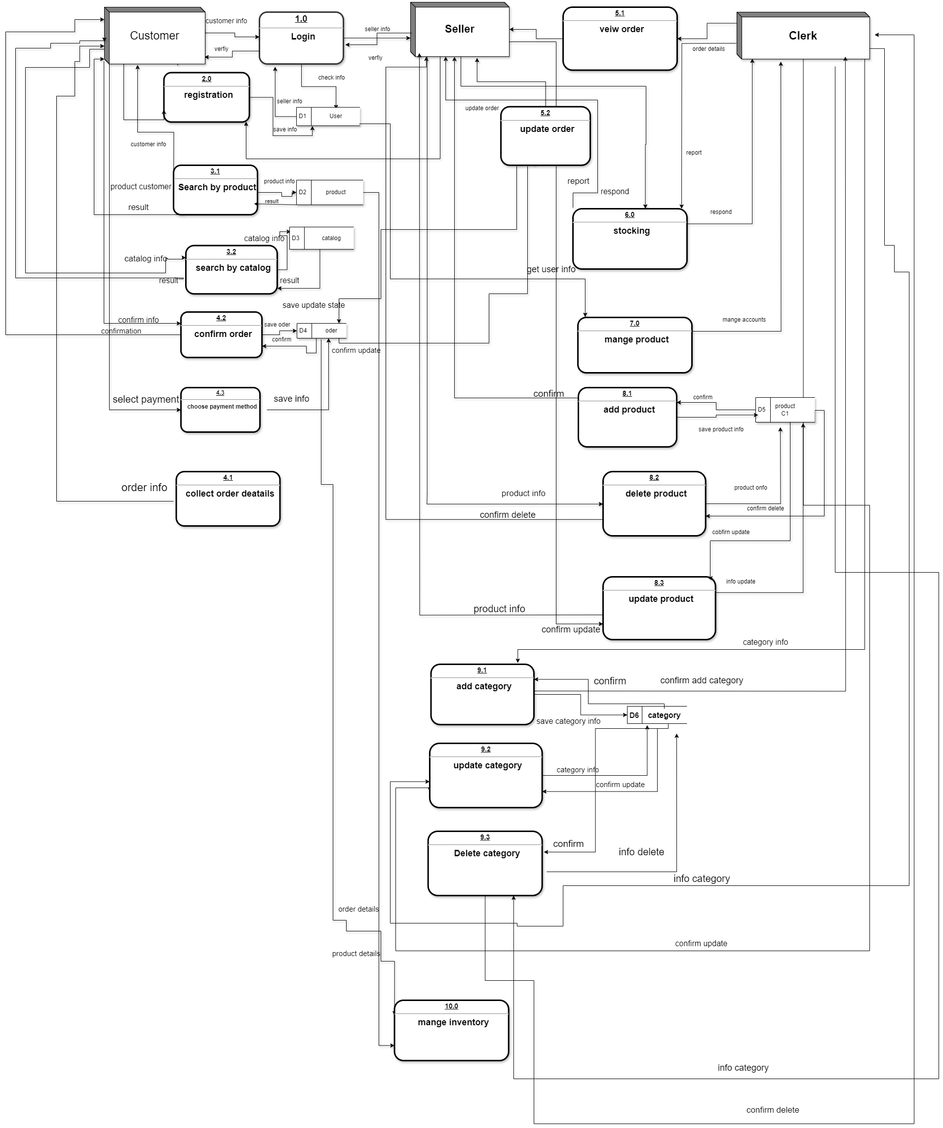
DFD LEVEL 1

Slide 34
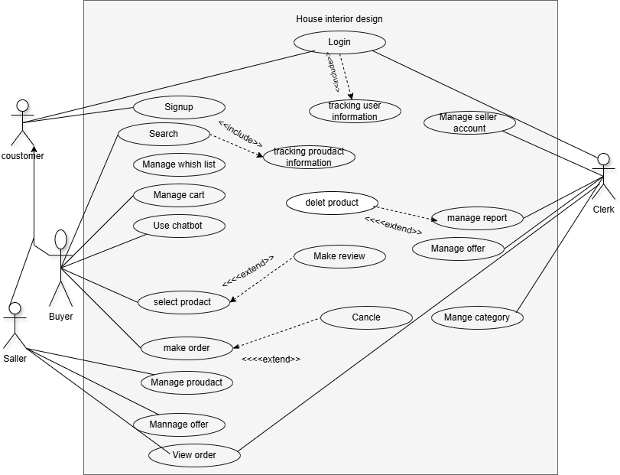
Use Case

Slide 35
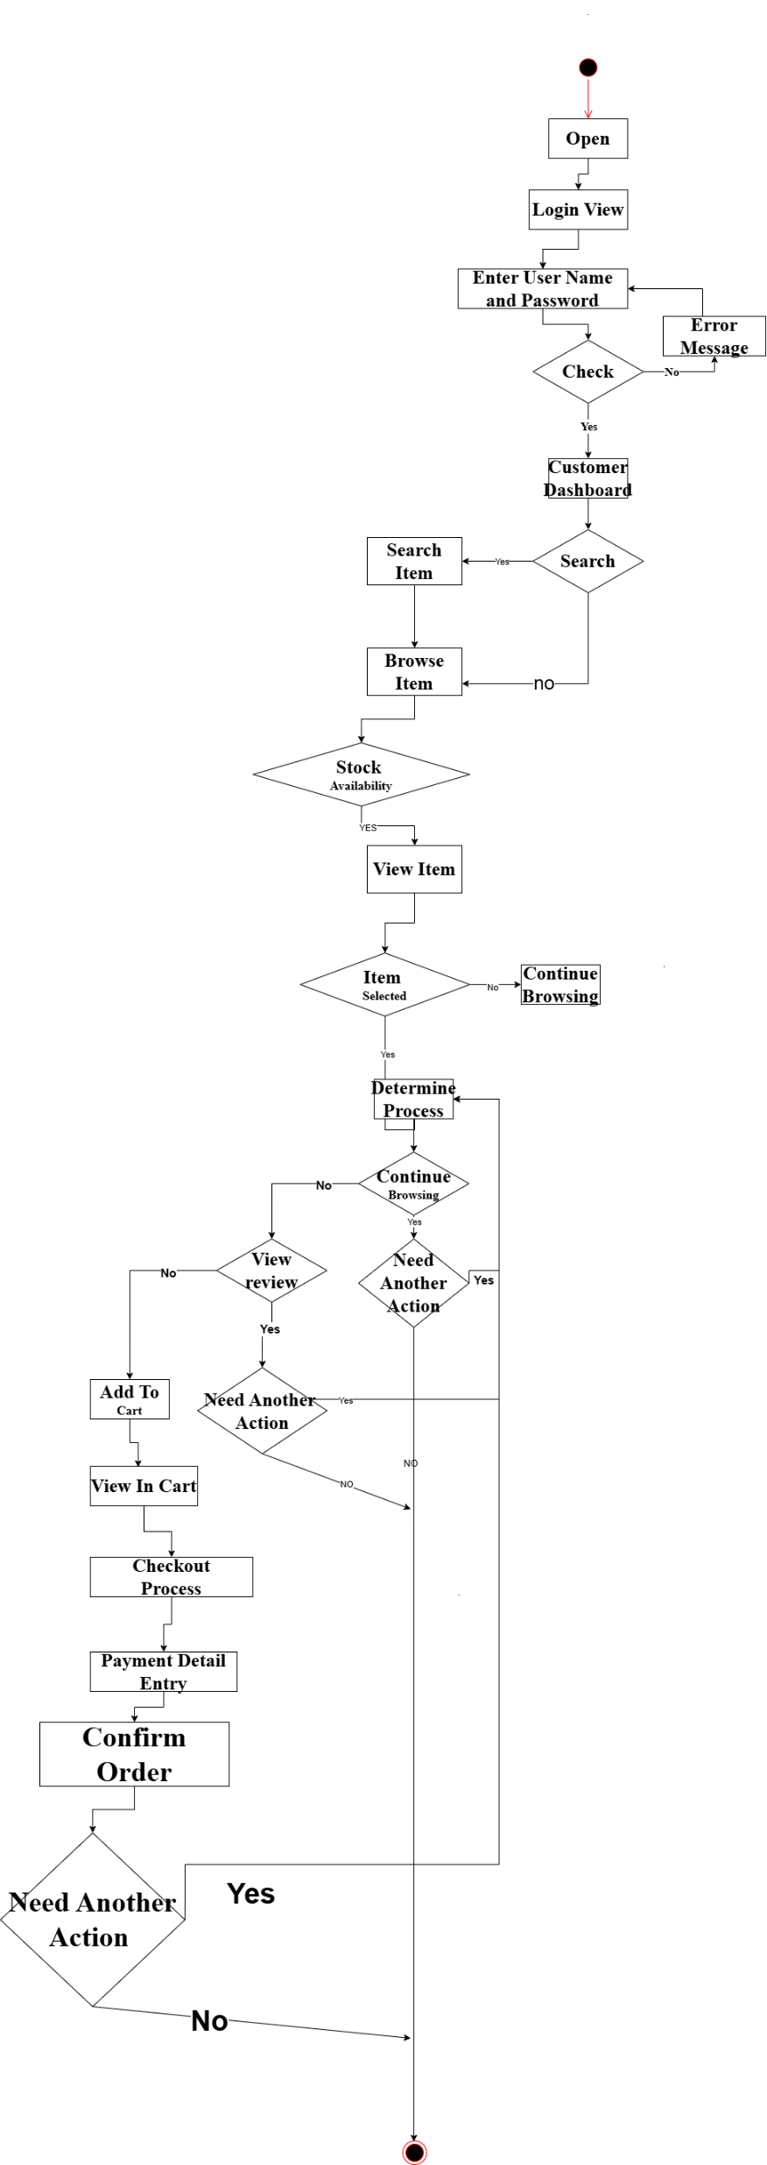
Activity Diagram(Buyer)

Slide 36
Activity Diagram(Buyer)

Slide 37
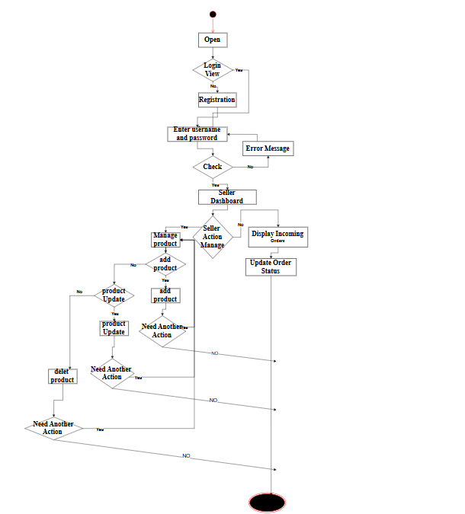
Activity Diagram(Seller)

Slide 38
Activity Diagram(Seller)

Slide 39
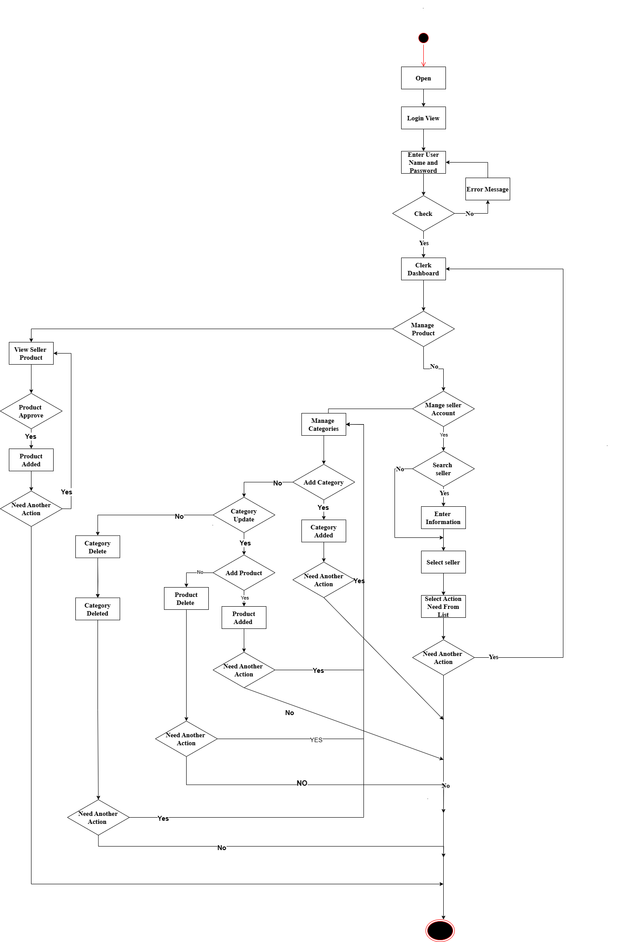
Activity Diagram(Clerk)

Slide 40
Activity Diagram(Clerk)

Slide 41
Class Diagram

Slide 42
Sequence Diagram (Cont.)
Sign-up
The customer opens the application and navigates to the sign-up form.
The customer enters the required sign-up details (e.g., name, email, password).
The interface validates the entered data format locally.
The interface sends the sign-up request to the Control system.
The Control system processes the request and forwards the user details to the User Database for saving.
The User Database saves the new user details and confirms successful storage.
The Control system notifies the interface about the result of the operation.
The interface displays a success message to the customer.

Slide 43
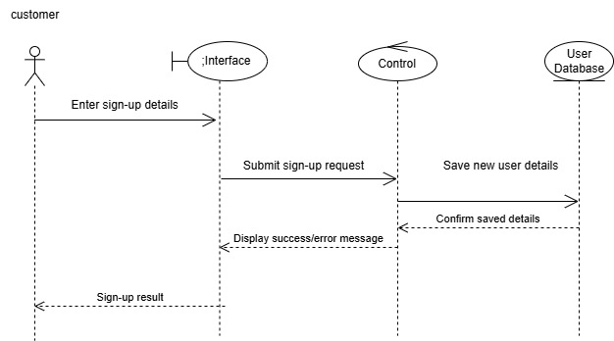
Sequence Diagram (Cont.)
Sign-up

Slide 44
Sequence Diagram (Cont.)
Login
The customer inputs their username and password in the interface.
The interface verifies the format of the input data locally (e.g., non-empty fields, valid characters).
If the username or password format is invalid (e.g., missing or incorrect), the interface displays an "Invalid Input" error message to the customer.
The customer corrects their input and resubmits the login request.
If the input is valid, the interface sends a login request to the Control system.
The Control system forwards the credentials to the User Database for verification.
The User Database verifies the username and password.
The verification result (success or failure) is sent back to the Control system.
The Control system forwards the result to the interface.
The interface displays a success message and logs the customer into the system.

Slide 45
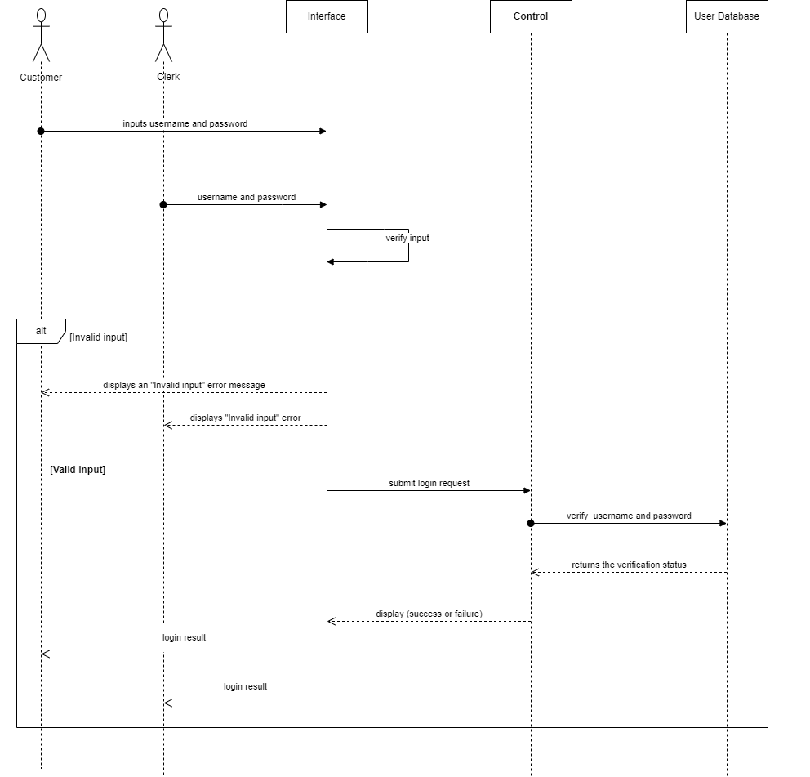
Sequence Diagram (Cont.)
Login

Slide 46
Sequence Diagram (Cont.)
Edit profile
The user selects the "Edit Profile" option from the interface.
The interface sends a request to the control component to open the "Edit Profile" page.
The control component retrieves the profile information from the user database and sends it back to the interface.
The interface displays the "Edit Profile" page to the user with the current profile details.
The user modifies the required information and submits the changes by entering a keyword or triggering an update.
The interface sends the updated information to the control component.
The control component processes the updated information and saves it to the user database.
The control component confirms the successful update and returns this confirmation to the interface.
The interface displays the updated profile details to the user.

Slide 47
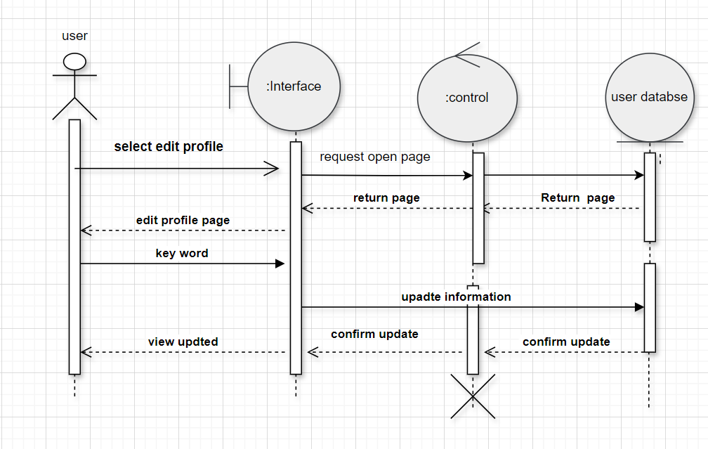
Sequence Diagram (Cont.)
Edit profile

Slide 48
Sequence Diagram (Cont.)
View Product
The Buyer selects a product through the Interface.
The Interface sends a request to the Control component to fetch details for the selected product.
The Control requests product details from the Product Database.
The Product Database retrieves the requested details and sends them back to the Control.
The Control forwards the product details to the Interface.
The Interface displays the product details to the Buyer.

Slide 49
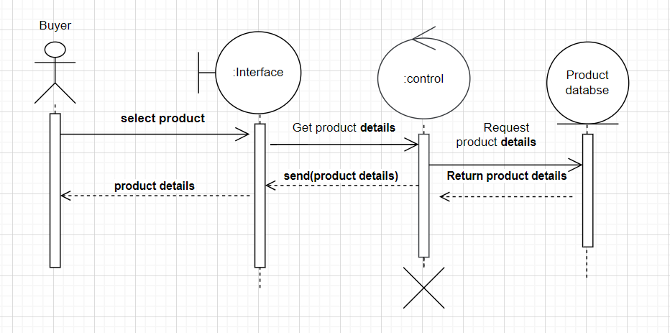
Sequence Diagram (Cont.)
View Product

Slide 50
Sequence Diagram (Cont.)
Make Review
The buyer selects a product to view.
The interface sends a request to the control component to retrieve product details.
The control component retrieves the product details from the product database.
The product details are returned to the interface and displayed to the buyer.
The buyer enters a review for the selected product.
The interface sends the review to the control component.
The control component processes the review and saves it to the review database.
The review database confirms that the review has been successfully added.
The control component sends the confirmation back to the interface.
The interface displays a message to the buyer confirming that the review has been added.

Slide 51
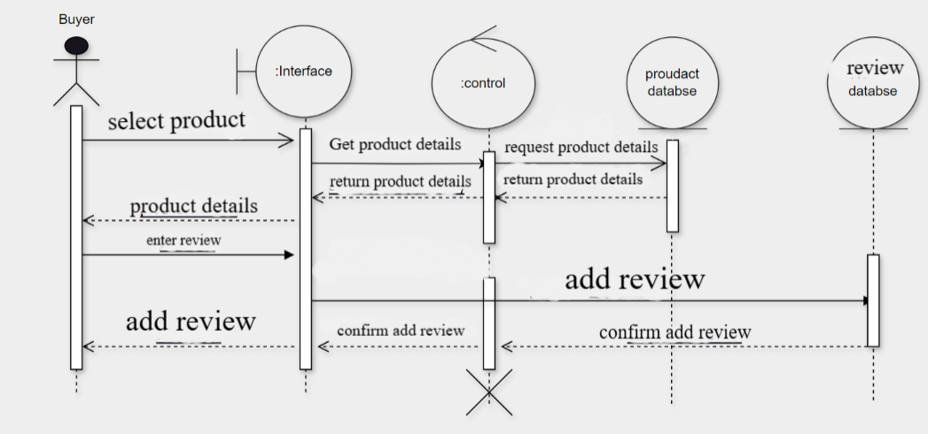
Sequence Diagram (Cont.)
Make Review

Slide 52
Sequence Diagram (Cont.)
View order
The seller initiates a request to view their orders through the interface.
The interface forwards the request to the Control system.
The Control system sends a query to the Order Database to retrieve the order data.
The Order Database processes the query and returns the requested order details to the Control system.
The Control system sends the order details to the interface.
The interface displays the order details to the seller.

Slide 53
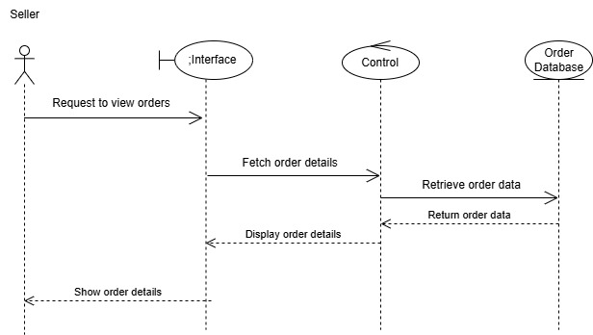
Sequence Diagram (Cont.)
View order

Slide 54
Sequence Diagram (Cont.)
Cancel Order
The buyer initiates the process by selecting an order to view its details.
The system retrieves the order details from the database and displays them to the buyer.
The buyer chooses to cancel the selected order.
The system validates the cancellation request and confirms with the buyer.
The system updates the database to mark the order as canceled.
The system notifies the buyer that the cancellation was successful.

Slide 55
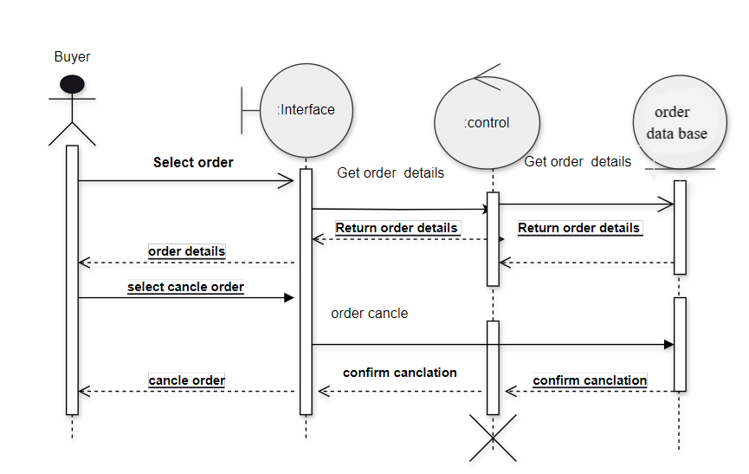
Sequence Diagram (Cont.)
Cancel Order

Slide 56
Sequence Diagram (Cont.)
Manage Product
The seller selects the "Manage Product" option in the interface.
The system retrieves the product list from the product database and displays it.
Seller adds, edits, or deletes a product through the interface.
The system processes the update request and modifies the product details in the product database.
A confirmation is sent back to the seller, indicating the product has been added, edited, or deleted.
the clerk views all products submitted by sellers for review through the interface.
The system retrieves the full list of products from the product database and displays it.
Clerk selects to approve or reject specific products.
The system updates the product status in the product database accordingly.
Notification of approval or rejection is sent to the seller.

Slide 57
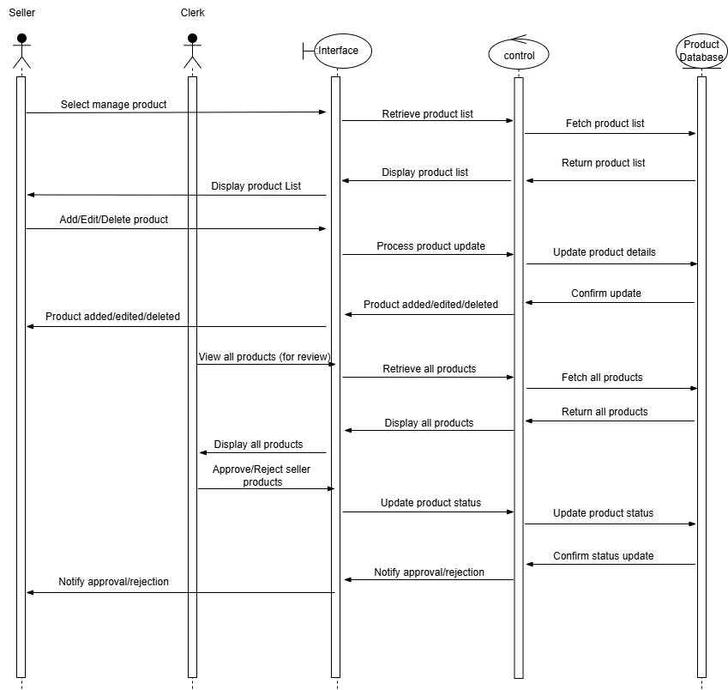
Sequence Diagram (Cont.)
Manage Product

Slide 58
Sequence Diagram (Cont.)
Manage User Acount
The clerk selects the "Manage User Account" option on the interface.
The system requests the user list from the control component.
The control component fetches the user list from the user database and returns it.
The system displays the user list to the clerk.
The clerk selects a specific user account from the displayed list.
The system requests the data of the selected user from the control component.
The control component retrieves the user data from the user database and returns it.
The system displays the selected user's detailed information to the clerk.
The clerk makes changes to the selected user's data and submits the update.
The system processes the update request and sends it to the control component.
The control component updates the user information in the user database.
A confirmation of the update is sent back to the system and displayed to the clerk.

Slide 59
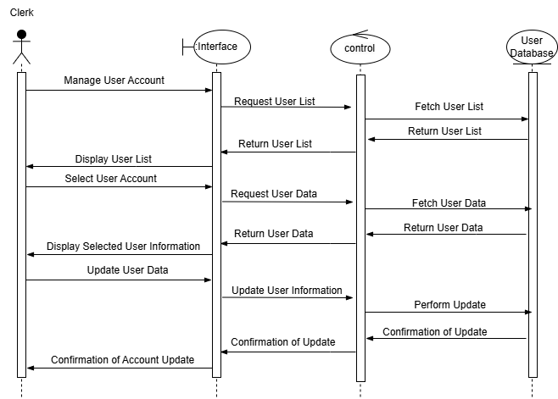
Sequence Diagram (Cont.)
Manage User Account

Slide 60
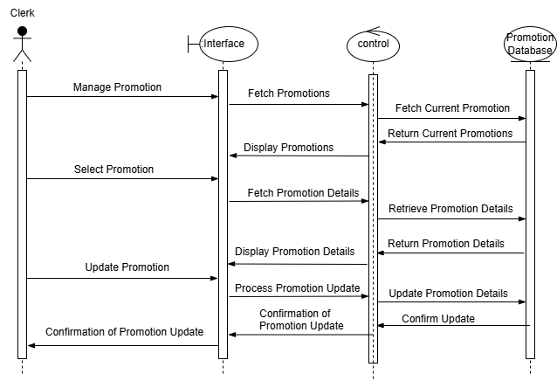
Sequence Diagram (Cont.)
Manage Promotion
The Clerk initiates the process by selecting the "Manage Promotion" option on the Interface.
The Interface sends a request to the Control component to fetch current promotions.
The Control queries the Promotion Database to retrieve current promotion data.
The Promotion Database returns the current promotions to the Control, which forwards them to the Interface for display to the Clerk.
The Clerk selects a specific promotion for more details.
The Interface requests detailed information about the selected promotion from the Control.
The Control retrieves the detailed promotion data from the Promotion Database.
The Promotion Database returns the promotion details to the Control, which sends them to the Interface for display to the Clerk.
The Clerk decides to update the promotion and inputs the updated information into the Interface.
The Interface sends the updated promotion data to the Control.
The Control processes the update and updates the promotion details in the Promotion Database.
The Promotion Database confirms the successful update to the Control.
The Control sends a confirmation message to the Interface, which is displayed to the Clerk.

Slide 61
Sequence Diagram (Cont.)
Make Report
The Clerk initiates the report creation process through the Interface.
The Interface displays available report options to the Clerk.
The Clerk selects the desired report type from the displayed options.
The Interface sends the report request to the Control component for processing.
The Control retrieves the necessary data for the report from the Report Database.
The Report Database returns the required data to the Control.
The Control generates the report using the retrieved data and sends it to the Interface.
The Interface displays the generated report to the Clerk.
The Clerk can choose to view the report on-screen or download it for offline use.

Slide 62
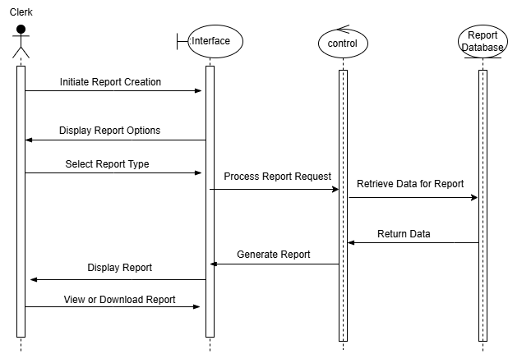
Sequence Diagram (Cont.)
Make Report

Slide 63
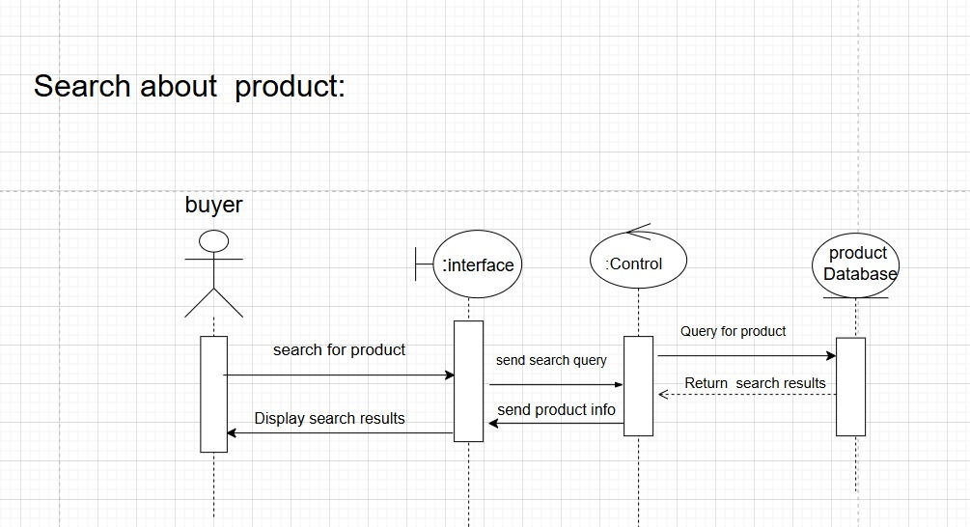
Sequence Diagram (Cont.)
Search

Slide 64
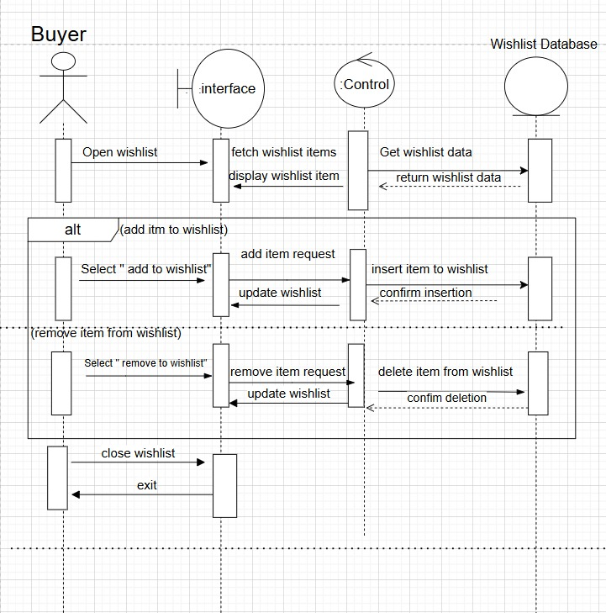
Sequence Diagram (Cont.)
Manage Wishlist

Slide 65
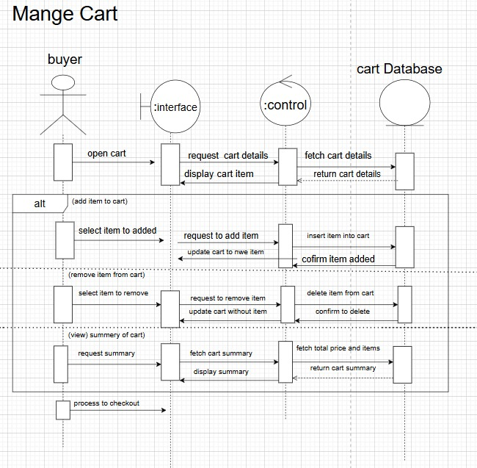
Sequence Diagram (Cont.)
Manage Cart

Slide 66
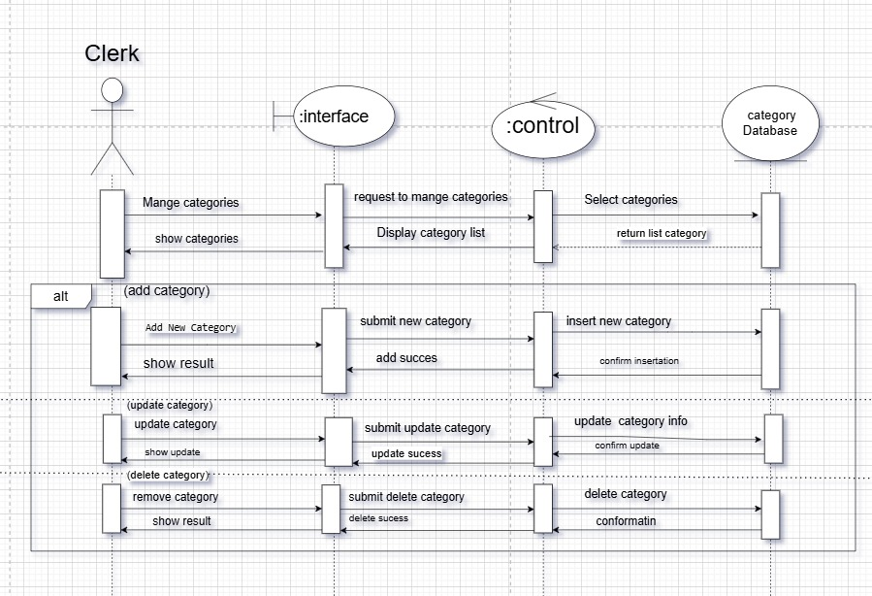
Sequence Diagram (Cont.)
Manage Category

Slide 67
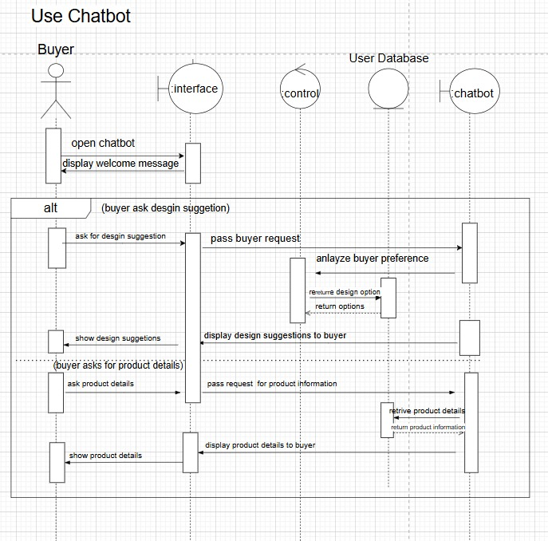
Sequence Diagram (Cont.)
Use Chatbot

Slide 68
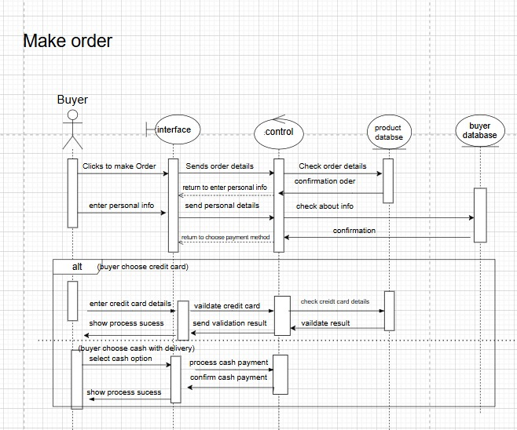
Sequence Diagram (Cont.)
Make Order

Slide 69
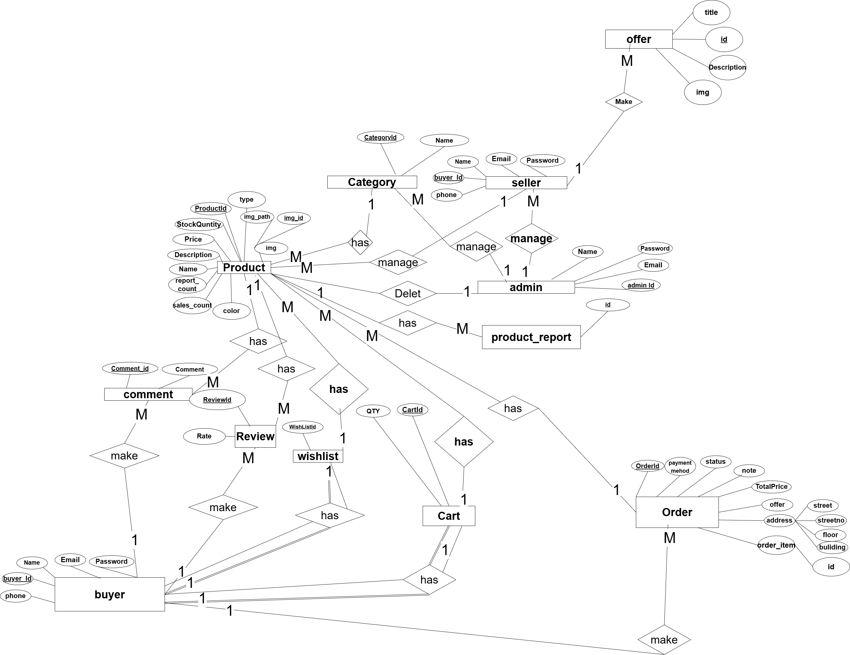
ER DIGRAM

Slide 70
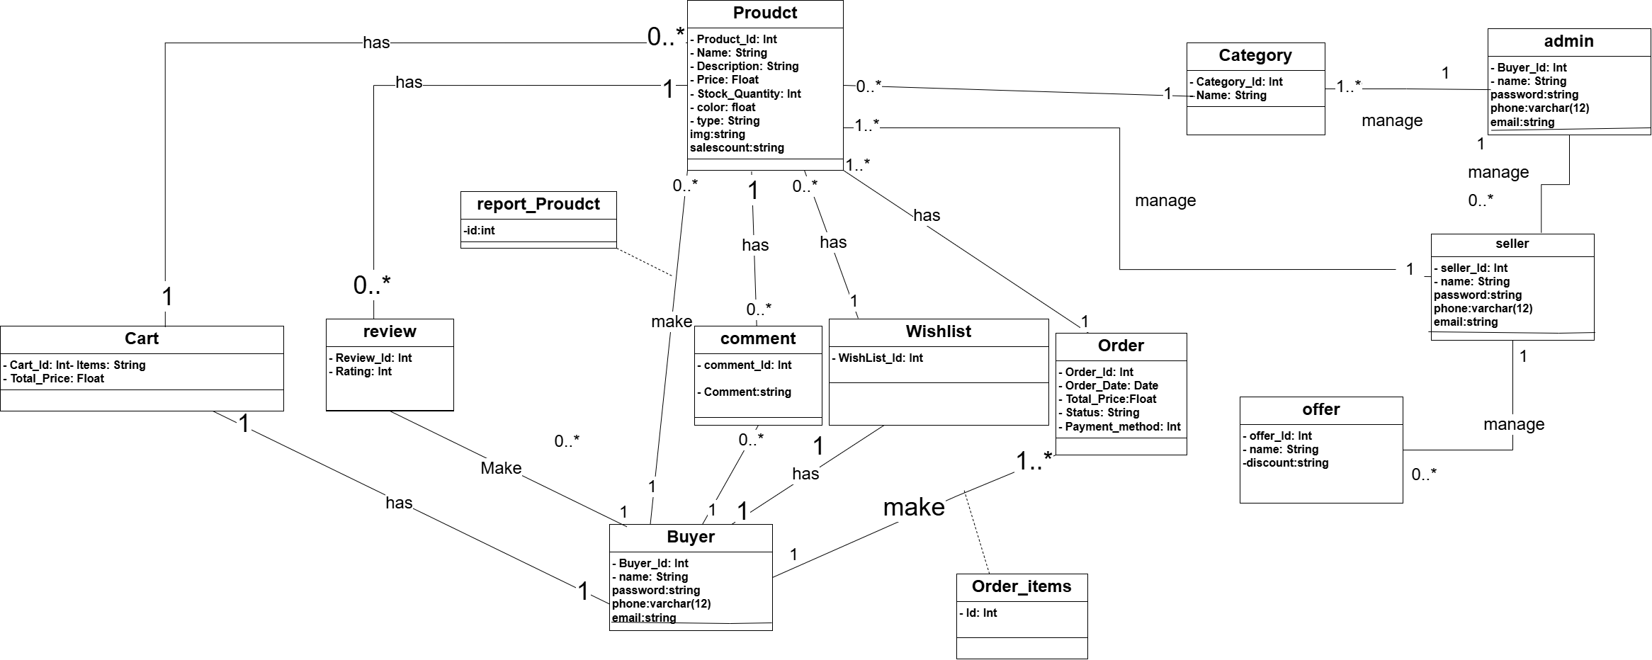
Class Diagram

Slide 71
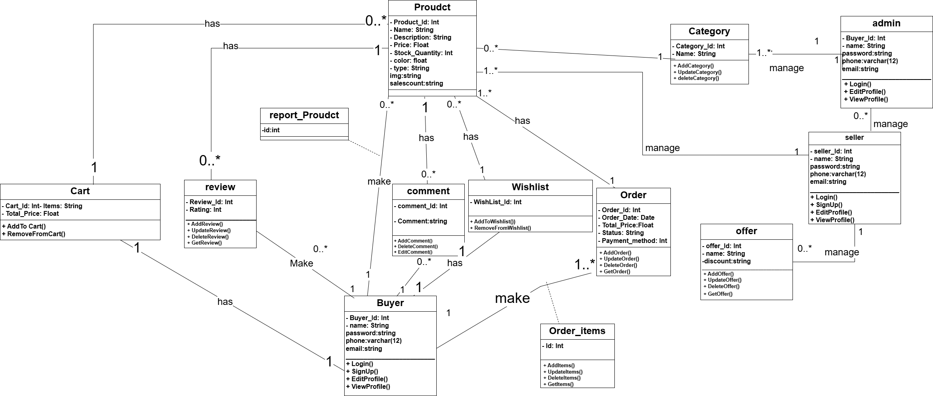
Class Diagram

Slide 72
AGENDA
01
06
PROBLEM STATEMENT
SYSTEM ANALYSIS PHASE
02
07
OBJECTIVES
SYSTEM DESIGN PHASE
03
08
SOLUTION APPROACH
IMPLEMENTATION PHASE
04
09
PROJECT PLANNING
System Testing
05
10
SURVEY & LITERATURE REVIEW
Conclusion &Future Work

Slide 73
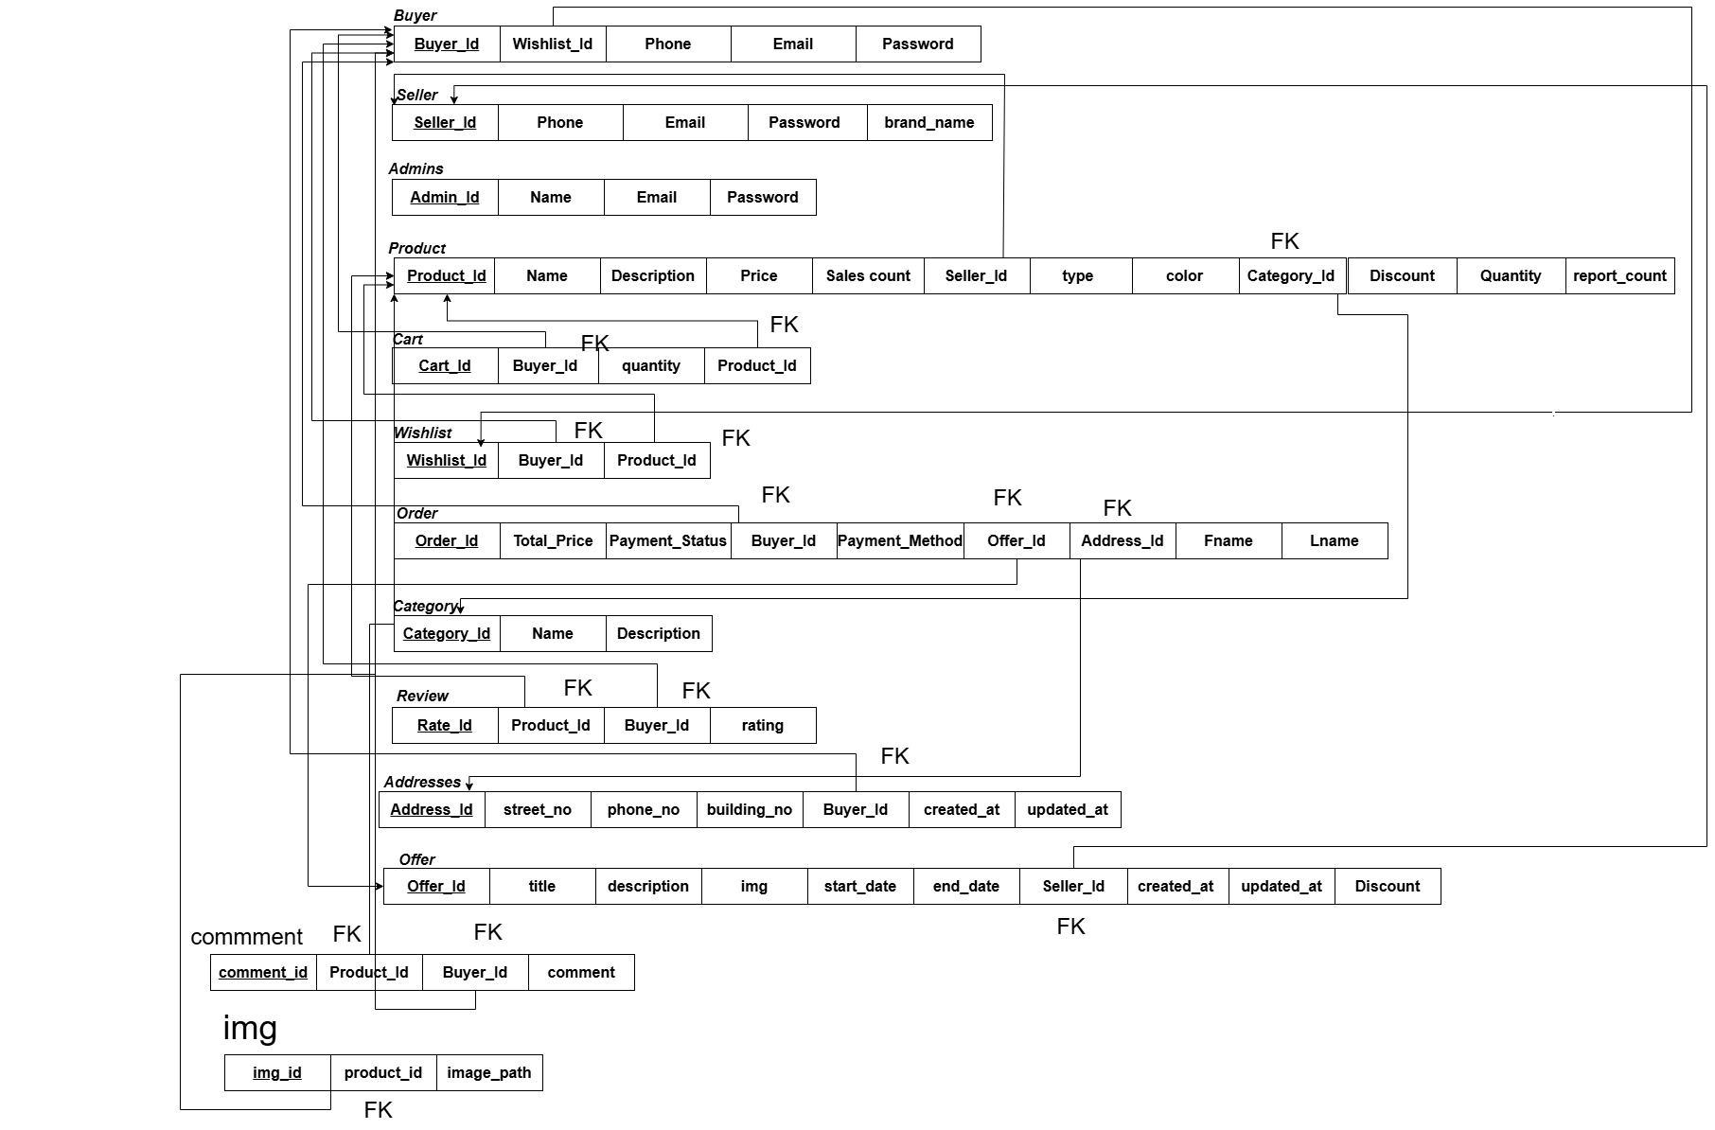
Schema

Slide 74
User Interface

Slide 75
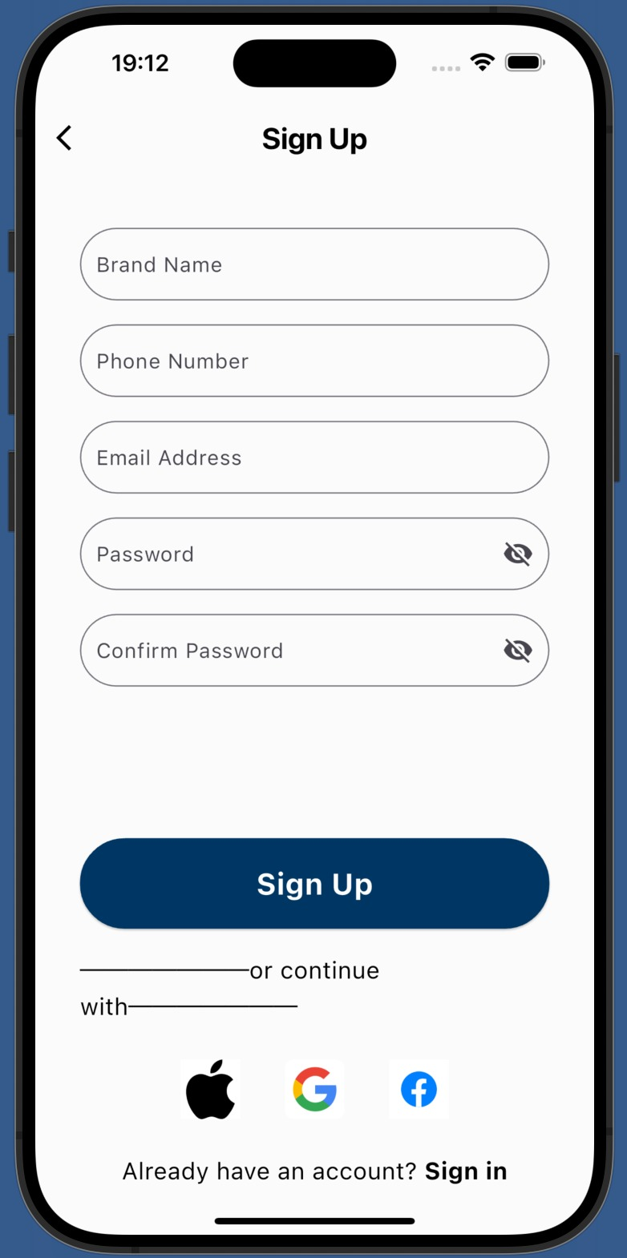
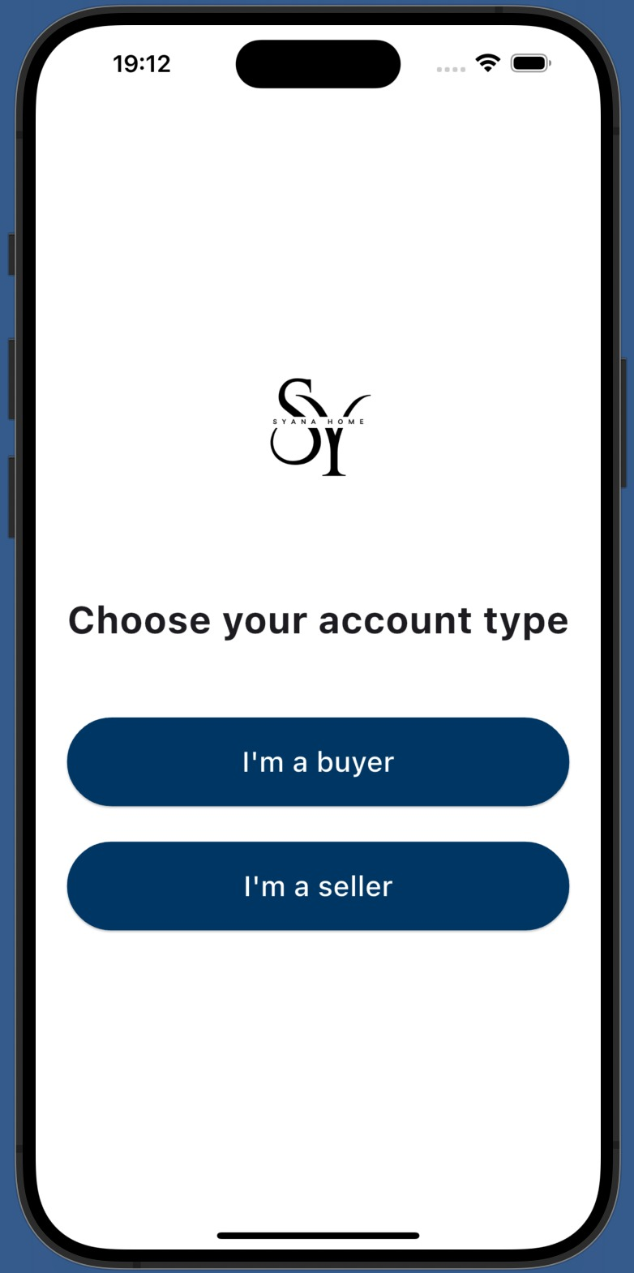
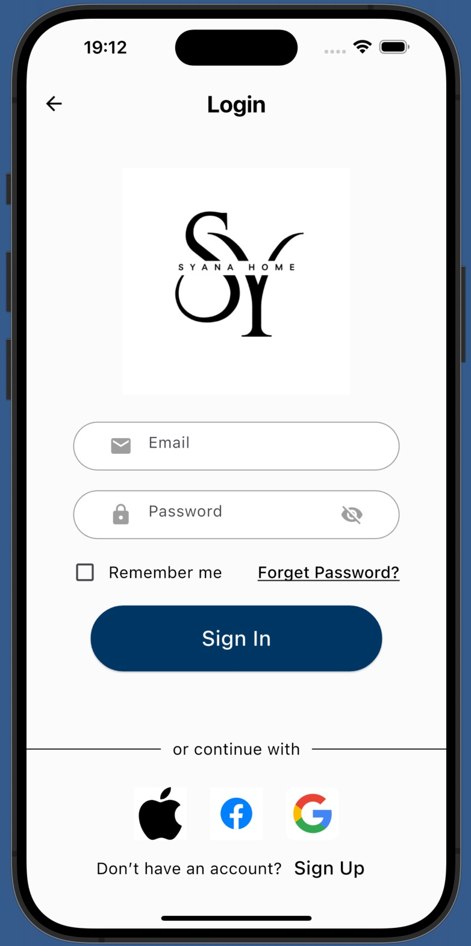
BUYER INTERFACE

Slide 76
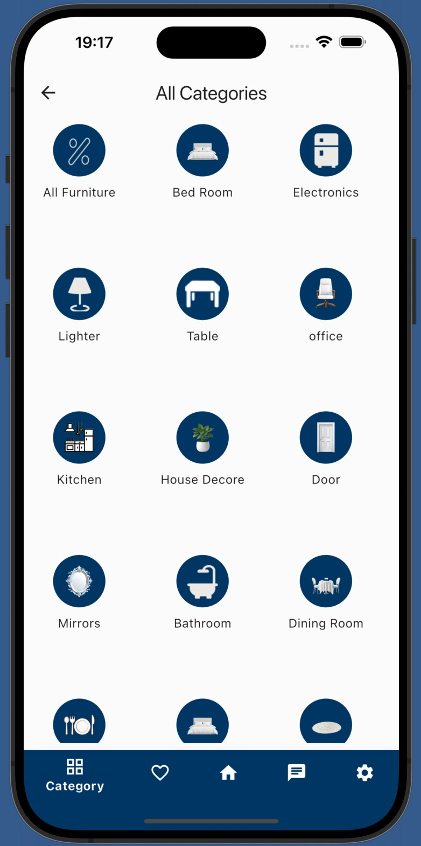
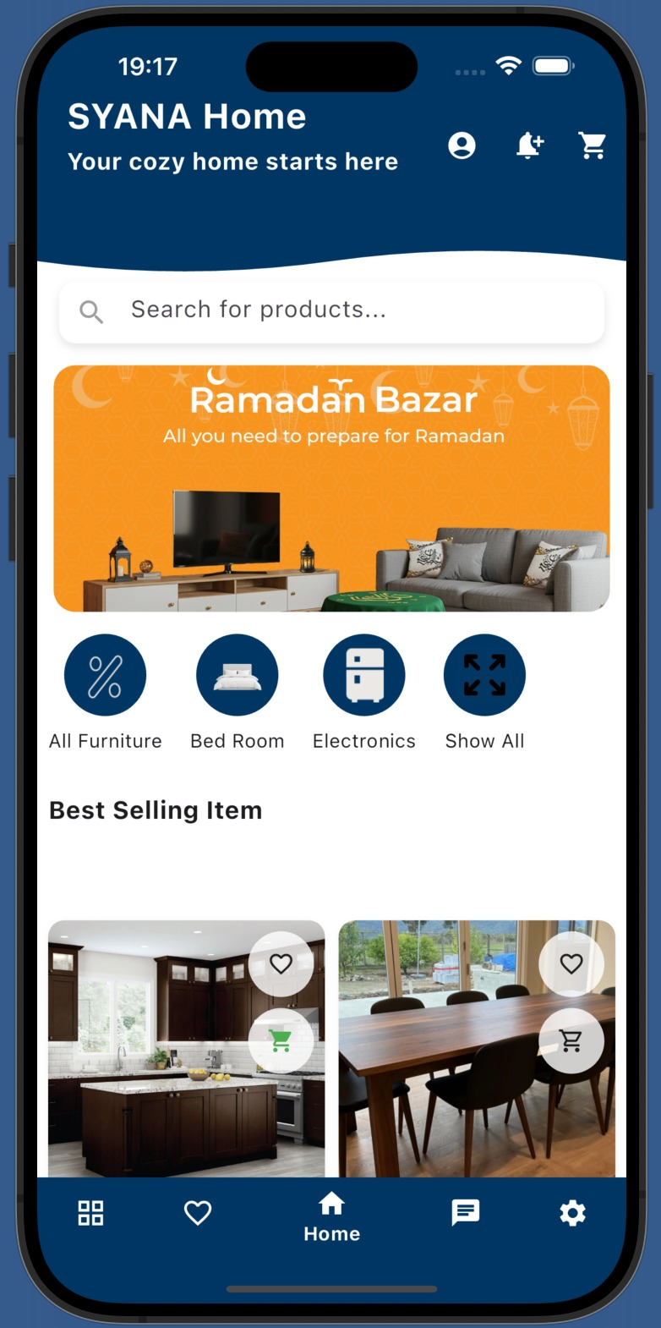
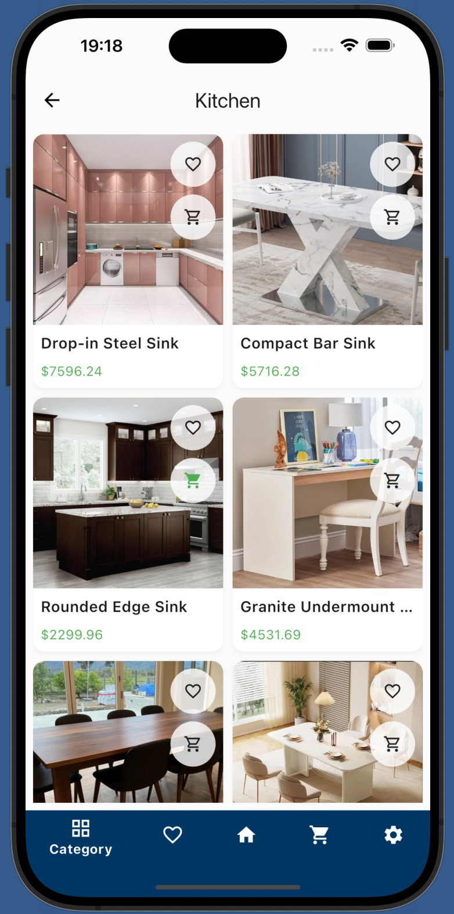
BUYER INTERFACE

Slide 77
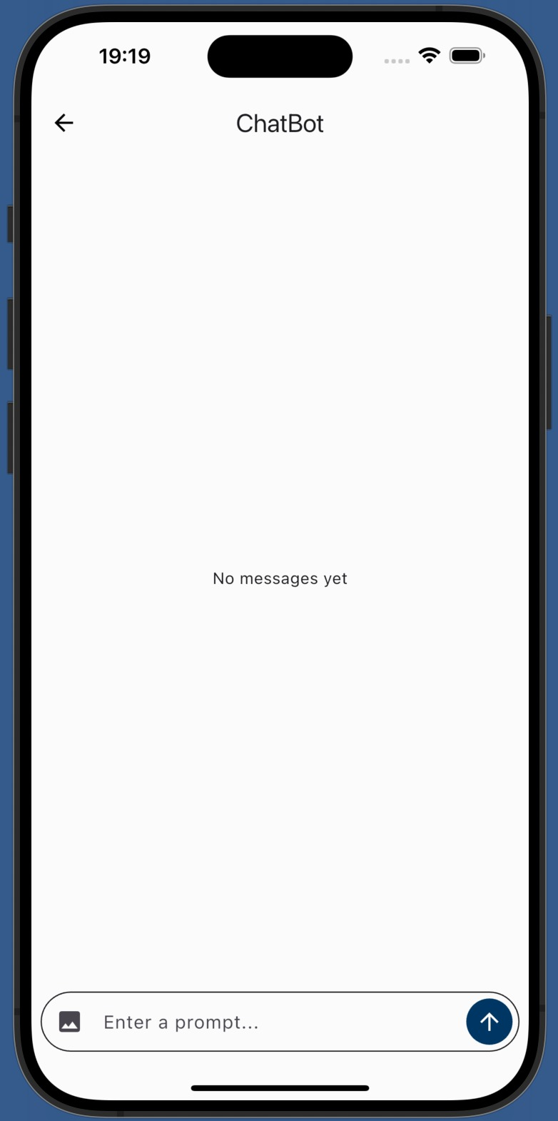
BUYER INTERFACE

Slide 78
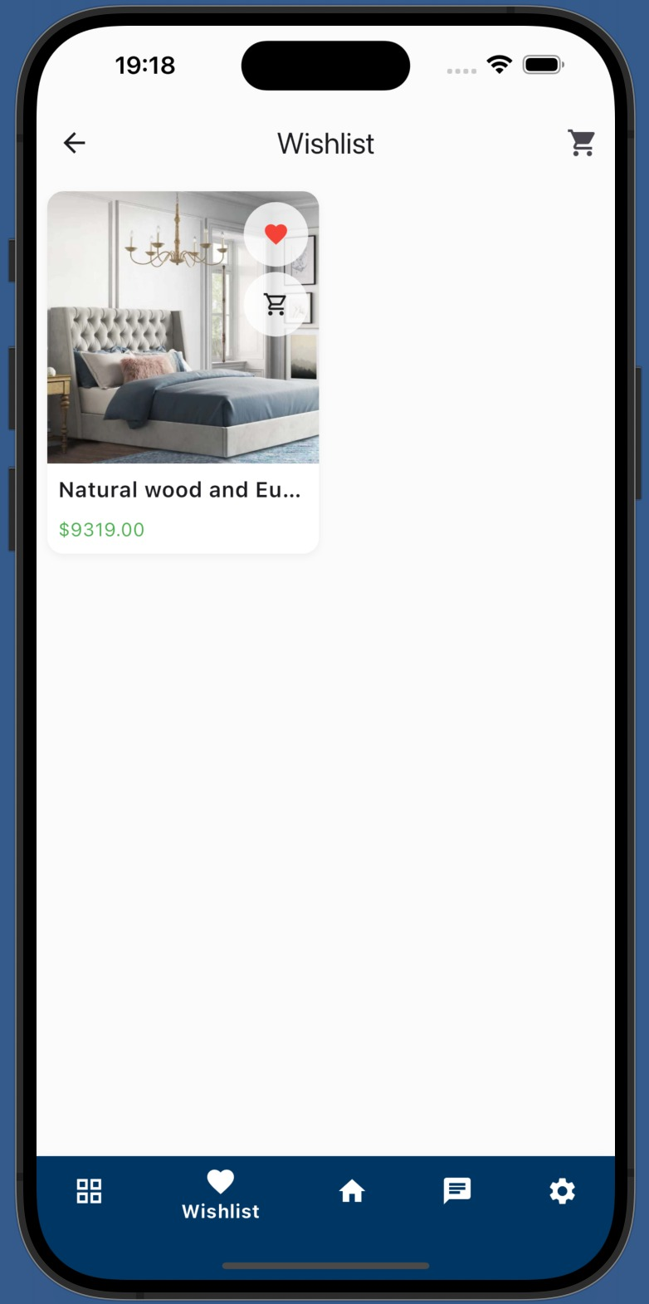
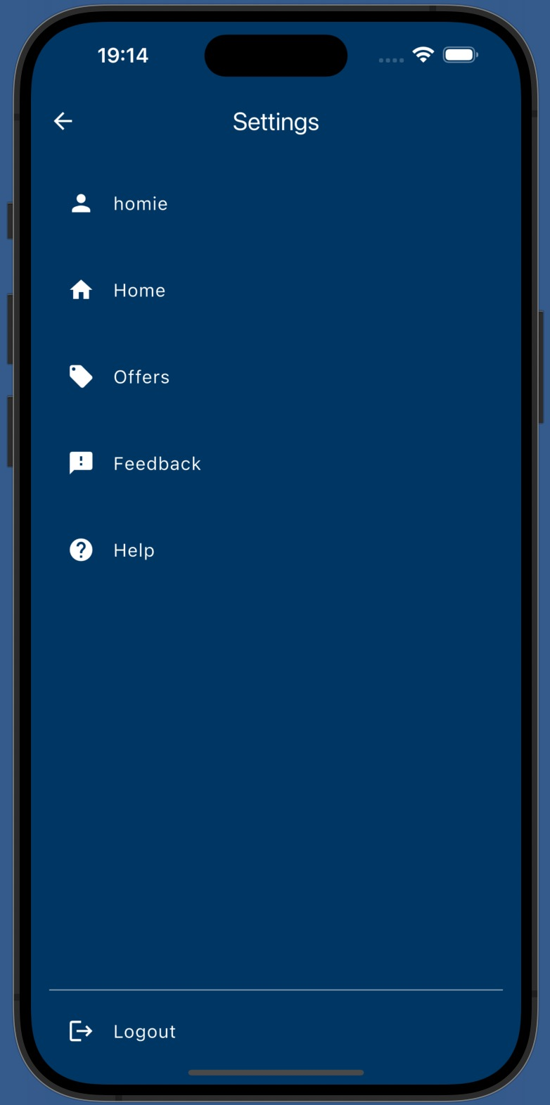
Buyer INTERFACE

Slide 79
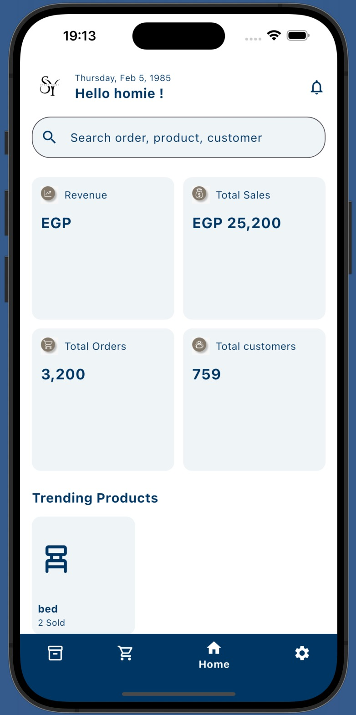
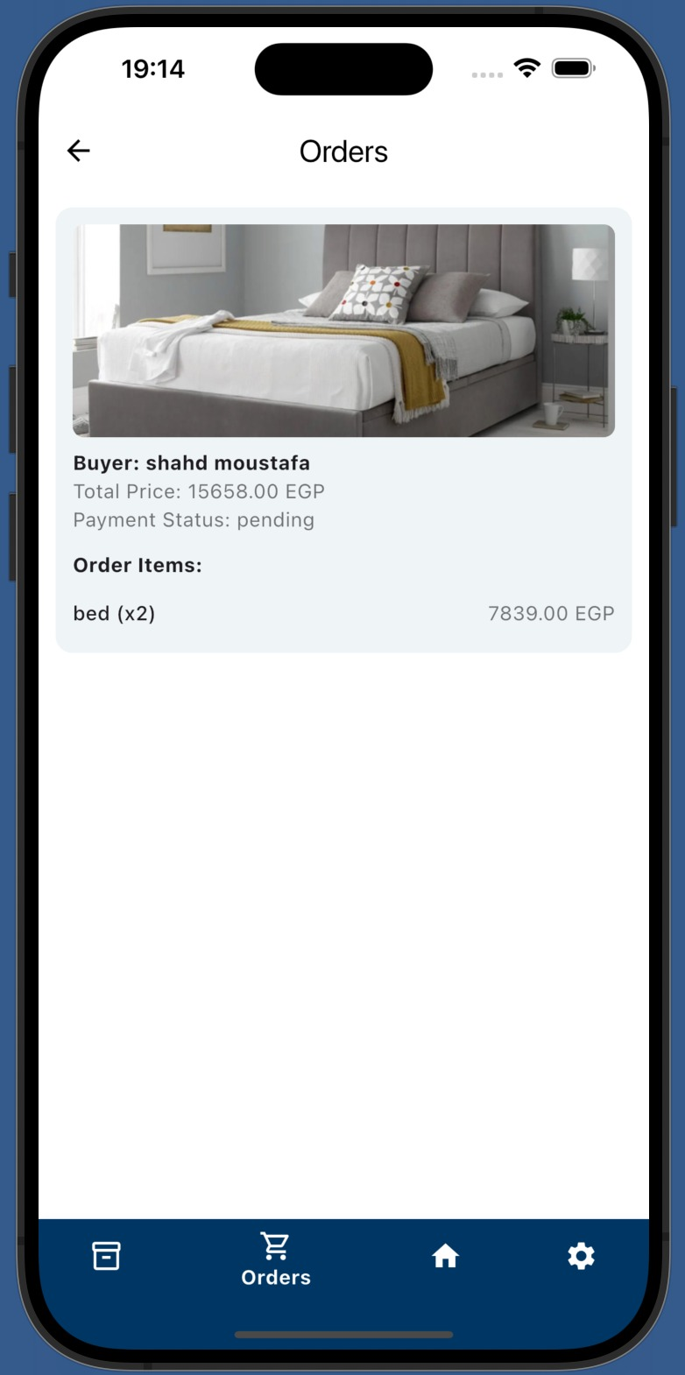
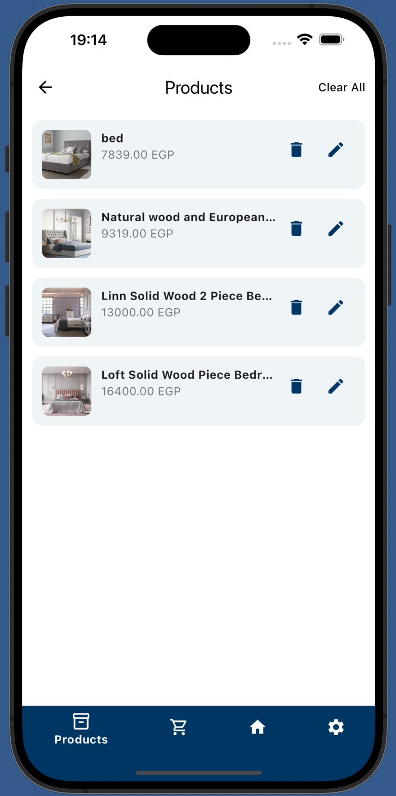
SELLER INTERFACE

Slide 80
AGENDA
01
06
PROBLEM STATEMENT
SYSTEM ANALYSIS PHASE
02
07
OBJECTIVES
SYSTEM DESIGN PHASE
03
08
SOLUTION APPROACH
IMPLEMENTATION PHASE
04
09
PROJECT PLANNING
System Testing
05
10
SURVEY & LITERATURE REVIEW
Conclusion &Future Work

Slide 81
SYSTEM IMPLMENTATION
Front-end
Back-end
Programming
language
Dart
PHP
Framework
Flutter
Laravel
Software
Android Studio
VS Code
Postman(for test Api)
We use MySQL database

Slide 82


System Implementation
Software Tools Used:
 | Flutter: Flutter is an open-source UI software development kit created by Google. It is used to develop cross platform applications.
 | Dart Programming language The Dart SDK is a set of tools and libraries provided by the Dart programming language for developing Dart applications. Dart is a client-optimized programming language developed by Google, designed for building web, mobile, and desktop applications.

Slide 83


System Implementation
Software Tools Used:
 | Android Studio (IDE) Android Studio is the official integrated development environment (IDE) for Google’s Android operating system. Used to develop Flutter Applications
 | Vs Code (IDE) Source-code editor made by Microsoft. Features include debugging, syntax highlighting, intelligent code completion, snippets, and code refactoring.

Slide 84


System Implementation
Software Tools Used:
 | Postman: Postman is a comprehensive tool for API development, testing, and management. User-Friendly Interface: It offers an intuitive user interface that simplifies the creation and sending of HTTP requests.
 | MySQL Server (Data Base) MySQL is a widely-used open-source relational database management system (RDBMS) that is free and available for various platforms. It is designed for high performance and is ideal for both small and large applications.

Slide 85

System Implementation
Software Tools Used:
 | PHP PHP is a free, open-source language used for building server-side logic and connecting mobile apps like Flutter to databases Supports easy API creation for handling authentication, data exchange, and MySQL database operations Fast and lightweight, with a large community and many ready-to-use libraries

Slide 86
AGENDA
01
06
PROBLEM STATEMENT
SYSTEM ANALYSIS PHASE
02
07
OBJECTIVES
SYSTEM DESIGN PHASE
03
08
SOLUTION APPROACH
IMPLEMENTATION PHASE
04
09
PROJECT PLANNING
System Testing
05
10
SURVEY & LITERATURE REVIEW
Conclusion &Future Work

Slide 87


Valid Credentials (login))
Test Case | Test Steps | Expected Result
Valid Credentials | Enter Valid Email Enter Valid Password Hit Login | Users successfully logged into their account and redirected to the dashboard or homepage.

Slide 88

Valid Credentials (login)
Test Case | Test Steps | Expected Result
Invalid Credentials | Enter Invalid Email Enter Invalid Password Hit Login | Error message displayed indicating invalid Credentials.

Slide 89


Add to cart
Test Case | Test Steps | Expected Result
Add to cart | Click on the button of add to cart. Go to cart to check if the product was added or no | Found the product on the cart

Slide 90

Search
Test Case | Test Steps | Expected Result
Search | Enter the key word that you want to search the product that have the same key word | Display all product countian the same word

Slide 91
AGENDA
01
06
PROBLEM STATEMENT
SYSTEM ANALYSIS PHASE
02
07
OBJECTIVES
SYSTEM DESIGN PHASE
03
08
SOLUTION APPROACH
IMPLEMENTATION PHASE
04
09
PROJECT PLANNING
System Testing
05
10
SURVEY & LITERATURE REVIEW
Conclusion &Future Work

Slide 92
Conclusion
The application is designed to help buyers access a wide range of home essentials such as furniture, decorations, lighting, and more
The project helps sellers reach a larger number of customers and increase sales opportunities through a unified platform.
The application provides assistance through a chatbot to help buyers make decisions related to color coordination and interior design preferences
The application is designed to help sellers upload and manage their products, as well as track incoming orders efficiently

Slide 93
Future Work
Adding different languages to the application
Adding more payment methods .
Adding Augmented Reality (AR) features
Adding a customer support chat feature
Adding an AI-based recommendation system

Slide 94
AGENDA
01
06
PROBLEM STATEMENT
SYSTEM ANALYSIS PHASE
02
07
OBJECTIVES
SYSTEM DESIGN PHASE
03
08
SOLUTION APPROACH
IMPLEMENTATION PHASE
04
09
PROJECT PLANNING
System Testing
05
10
SURVEY & LITERATURE REVIEW
Conclusion &Future Work

Slide 96


THANK YOU!

